Slide 1
Testing of Hypotheses
Chapter # 10

Slide 2
Statistical Hypotheses
A statistical hypothesis, sometimes called confirmatory data analysis, is a hypothesis that is testable on the basis of observing a process that is modeled via a set of random variables. A statistical hypothesis test is a method of statistical inference

Slide 3
Null Hypotheses
A hypotheses which we want to test is called Null hypothesis Denoted by H_{o} .
Opposite to Null hypothesis is called Alternative Hypothesis denoted by H₁ .

Slide 4
Example
A car battery manufacturing company claims that the batteries they produce posses an average length of life 2 years. We can accept or reject their claims on the basis of sample by testing relevant hypothesis.
In this example the null hypothesis is that the average length of life is 2 years.
i.e H_{o} : μ=2
Alternative hypothesis may be stated as
H₁ : μ≠2 or H₁ : μ<2, μ>2

Slide 6
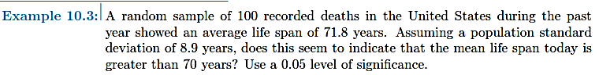

Slide 7
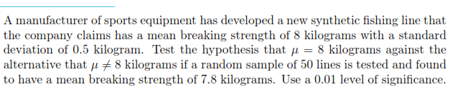

Slide 8
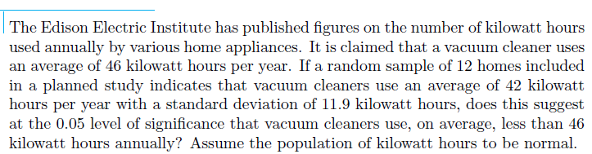

Slide 9

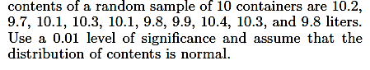
25

Slide 10
Ex: 10.19 – 10.26

Slide 11
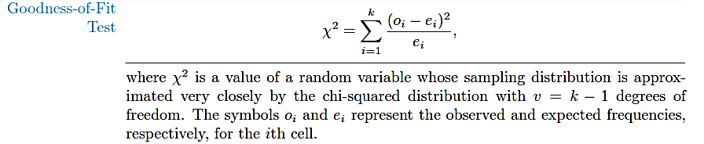
Goodness of fit.
Chi square

Slide 12
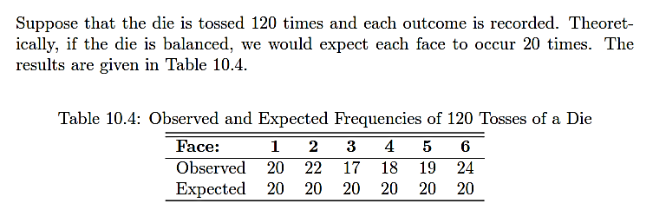

Slide 13

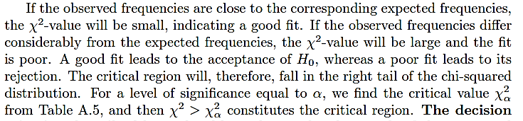

Slide 14
Solution:
H_{o} : Die is fair (Good fit)
H₁ : Die is not fair
⍺=0.05
Decision:
Accept H₀ (We conclude that there is insufficient evidence that die is not balanced)

Slide 15
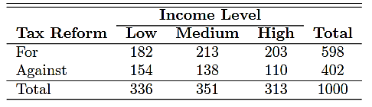
Test for Independence (Categorical Data)
Q) Determine whether the opinions of the voting residents of the state of Illinois concerning a new tax reform are independent of their levels of income. Members of a random sample of 1000 registered voters from the state of Illinois are classiﬁed as to whether they are in a low, medium, or high income bracket and whether or not they favor the tax reform. The observed frequencies are presented in the following Table
Notes:
If opinion are same than they are independent of their level of income.

Slide 16
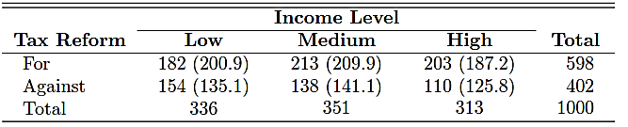
Solution:
Ho : Voter’s opinion and his/her level of income are independent
H1 : Voter’s opinion and his/her level of income are not independent
⍺=0.05
ʋ=(r - 1)(c - 1)
Decision: The null hypothesis is rejected and we conclude that a voter’s opinion concerning the tax reform and his or her level of income are not independent.

Slide 17
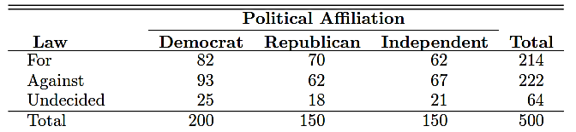
Q) Referring to the following data, test the hypothesis that opinions concerning the proposed law are the same within each political aﬃliation. Use a 0.05 level of signiﬁcance.

Slide 18
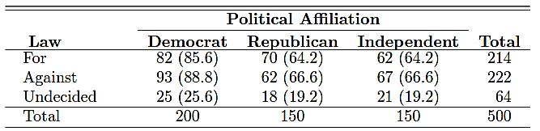

Slide 19
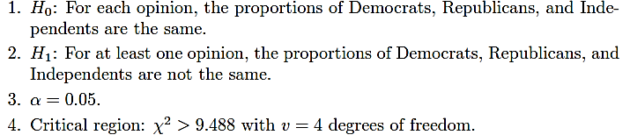
Solution:
5. Computation
6. Decision: Accept H_{o}. There is insuﬃcient evidence to conclude that the proportions of Democrats, Republicans, and Independents diﬀer for each stated opinion.

Slide 20

Testing of several proportion
Q) In a shop study, a set of data was collected to determine whether or not the proportion of defectives produced was the same for workers on the day, evening, and night shifts. The data collected are shown in the following Table. Use a 0.025 level of signiﬁcance to determine if the proportion of defectives is the same for all three shifts.

Slide 21
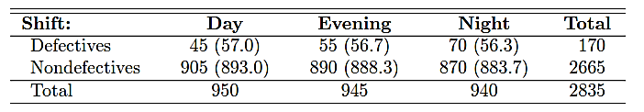
Solution

Slide 22
